Slide 1
Cluster Simulator
Alex S.
Clint R.
Ethan R.

Slide 2
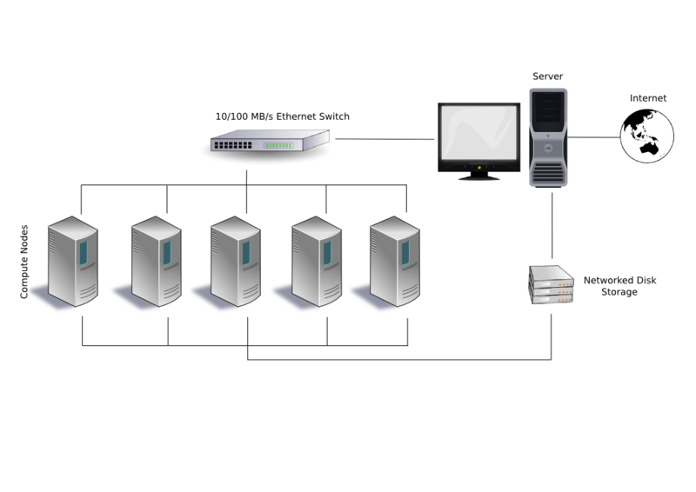
What is a cluster?
A network of processors acting as a single system
Parallel Processing
Load Balancing

Slide 3
Why a simulation?
Testing ideal conditions
Performance benchmark
“What If” testing

Slide 4
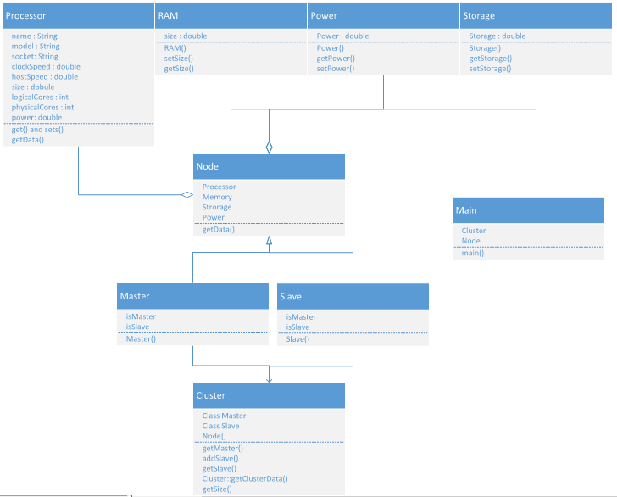
UML

Slide 5
DEMO

Slide 6
Future Tasks
Desired Functionality
Processor Choosing
Slave node cycling
Live Data Testing

Slide 7
Questions?

